Slide 1







Empower Your F&O Integrations with Azure API Management:
Unlocking Superpowers

Slide 2


Slide 3



Azure API MANAGEMENT

Slide 4





Azure API MANAGEMENT
Title
Notes:
Love story

Slide 5

Title
HTTP calls to F&O

Slide 6
What’s wrong
with F&O?
Notes:
From an API developer POV F&O custom web-services are rather dumb

Slide 7
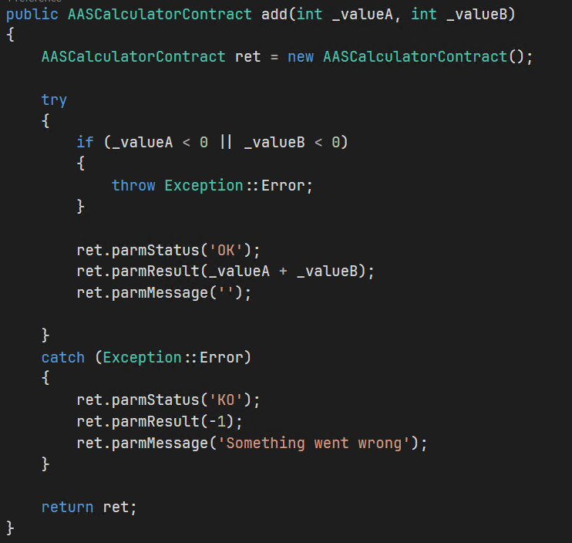
What’s wrong with F&O?
HTTP 200 OK
HTTP 400 Bad Request
HTTP 500 Server Error

Slide 8
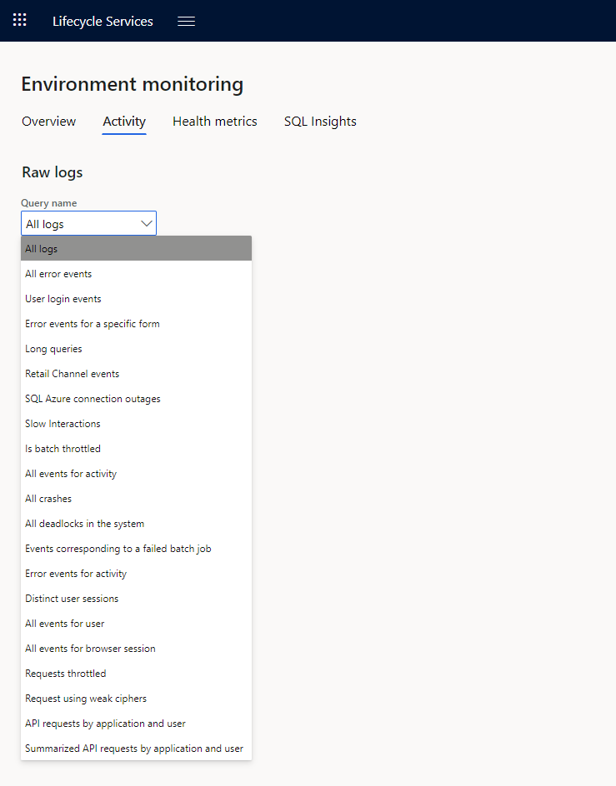

What’s wrong with F&O?

Slide 9
Azure API Management
Added security.
Limit call rates, or usage quotas.
Validation
Transform responses.
Segment access with subscription keys
Integrate multiple destinations
And much more I’ve never tried!!

Slide 10
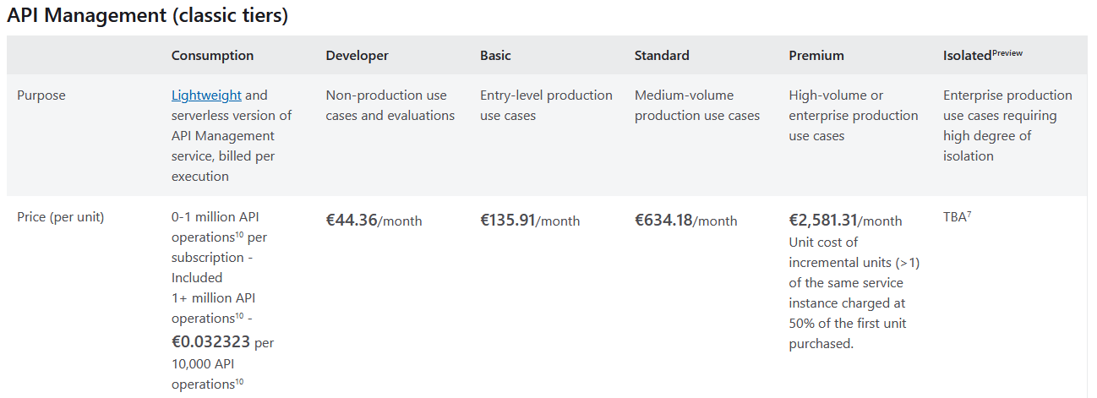
Azure API Management
Notes:
https://azure.microsoft.com/en-us/pricing/details/api-management/

Slide 11

Why Azure API Management?
Dynamics 365 F&O APIs
Notes:
Why add another layer to D365FO?

Slide 12

Why Azure API Management?
Dynamics 365 F&O APIs

Slide 13

Why Azure API Management?
Title
Notes:
I have trust issues, and I think that’s good when implementing an ERP. Specially when working with 3rd parties.
Same for security... Or we wouldn’t have passwords, MFA, etc...

Slide 14
Azure API Management
Logging!
One that’s not dumb, actually works and it’s useful…

Slide 15
Azure API Management
DEMO!

Slide 16
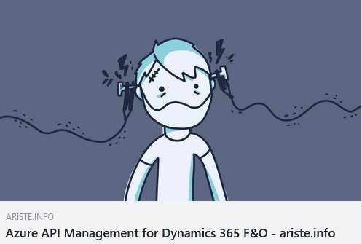
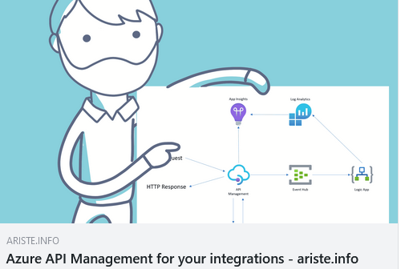
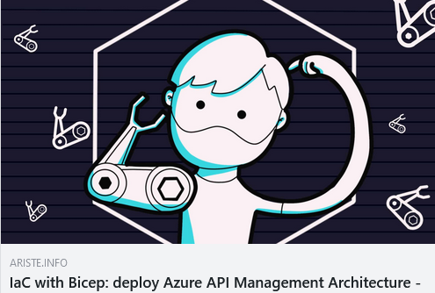
Want to learn more?
Visit my blog: ariste.info

Slide 17

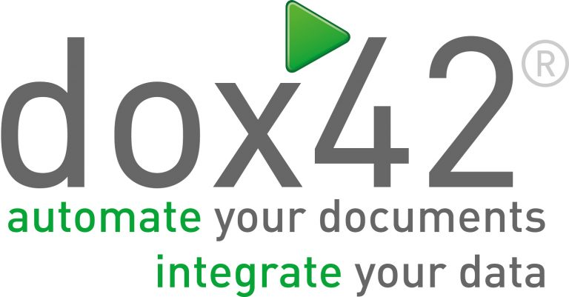




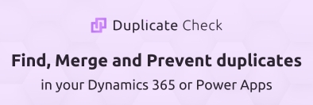

Sponsors
THANK
YOU!

